Slide 1
Surgical Drains ,Tubes ,Catheters and Cannulas

Slide 30
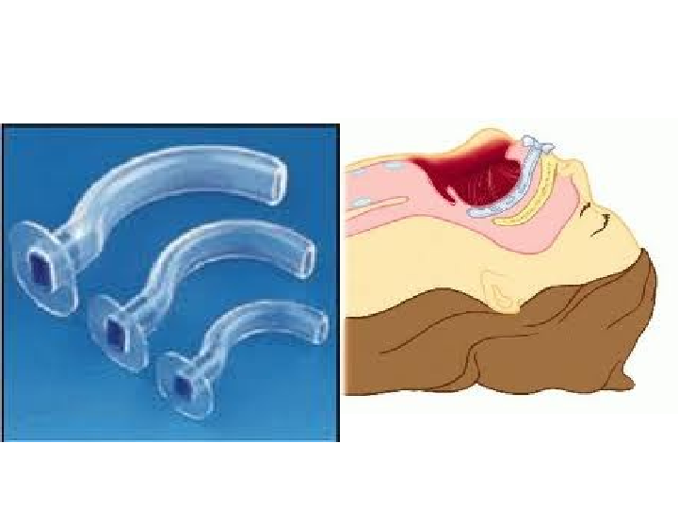
Respiratory drains and tubes: Airway

Slide 31
Laryngeal tube:

Slide 32
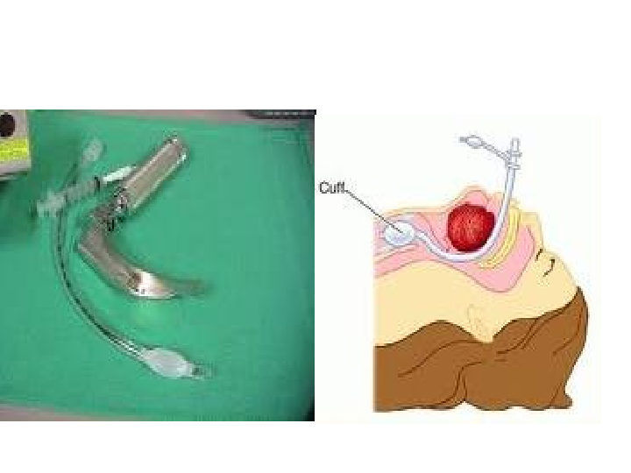
Endotracheal intubation

Slide 33
Cricothyroidotomy

Slide 34
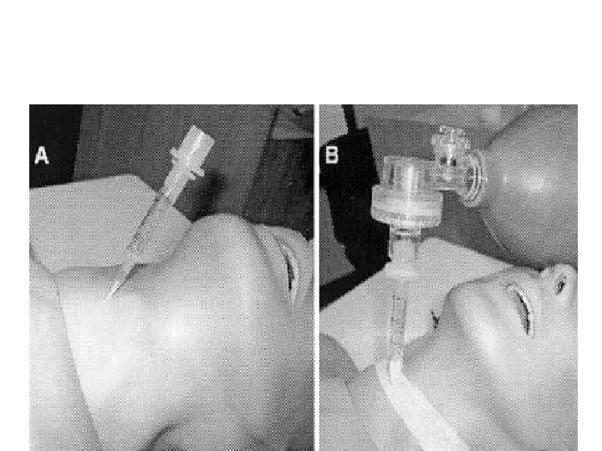
Cricothyroidotomy

Slide 35
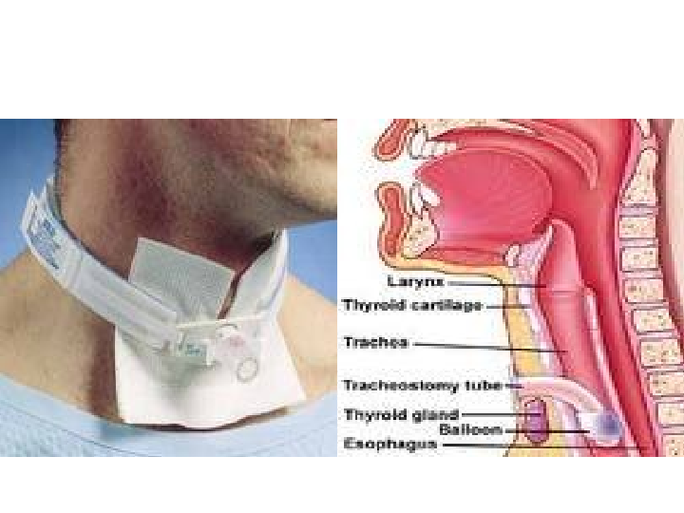
Tracheostomy tube

Slide 36
Chest tube

Slide 37
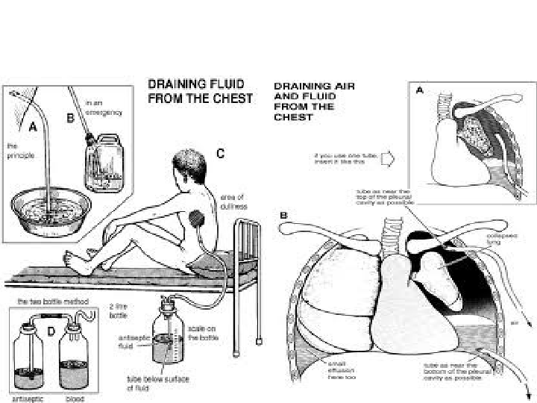
Chest tube

Slide 38
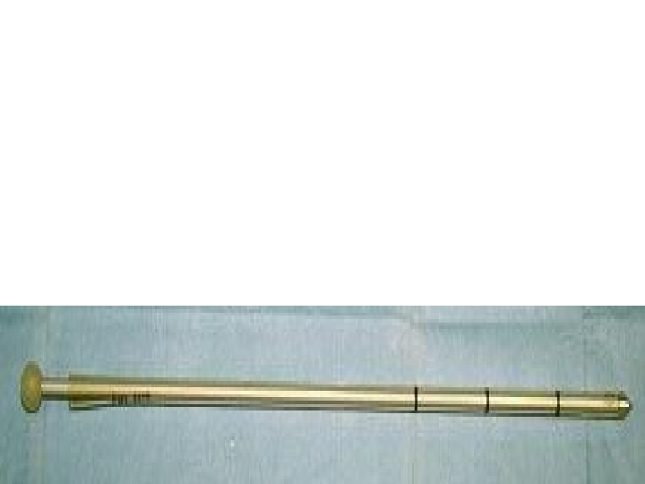
The Trocar catheter used for closed thoracostomy

Slide 39
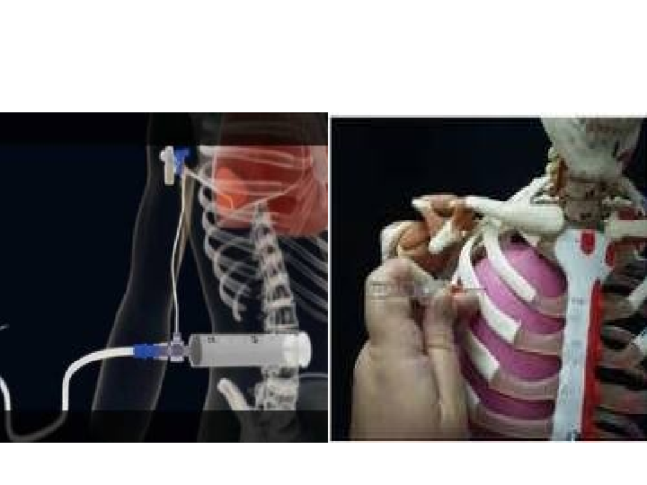
Thoracentesis needle

Slide 40
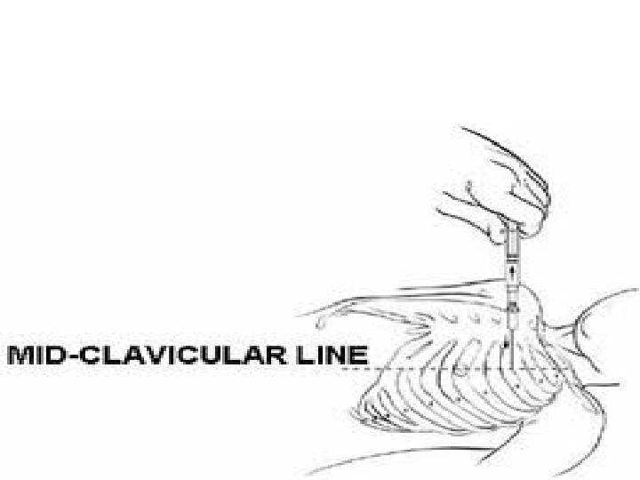

Slide 41
GIT Drains and tubes:

Slide 42
Nasogastric tube

Slide 43
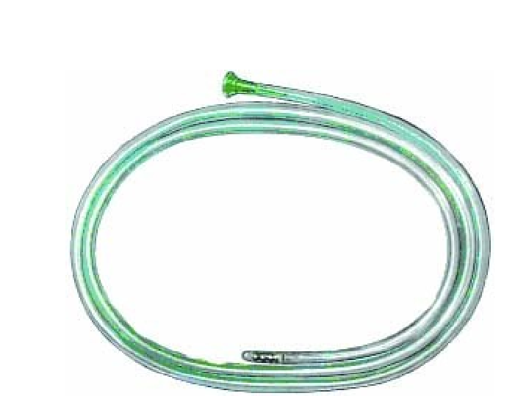
Ryle,s tube

Slide 44
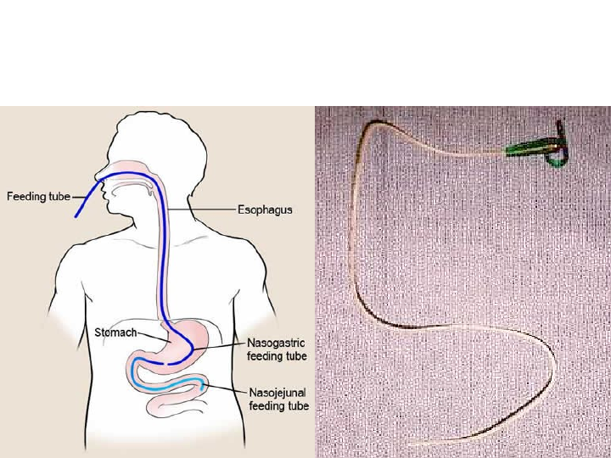
Nasogastric and nasojejunal feeding tube

Slide 45
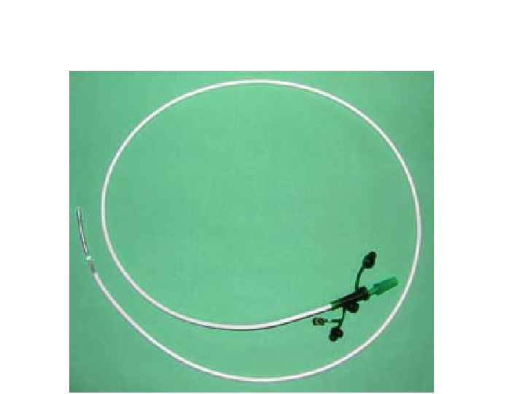
Feeding NGT

Slide 46
Rectal tube

Slide 47
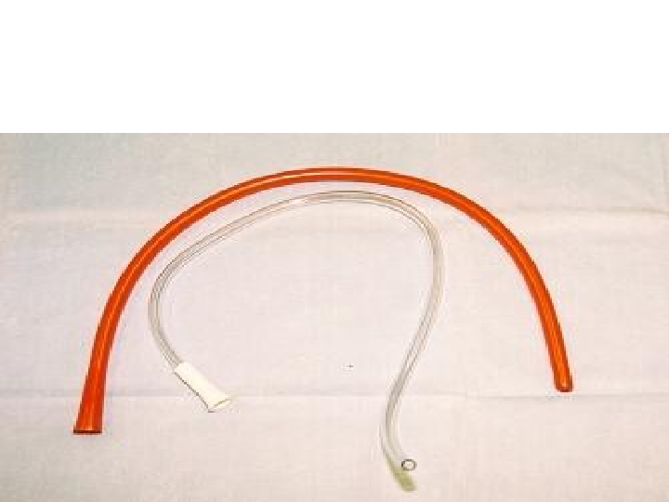
Rectal tube

Slide 48
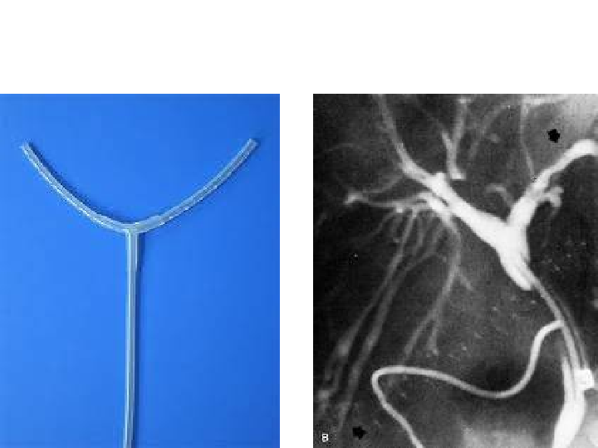
T-tube

Slide 49
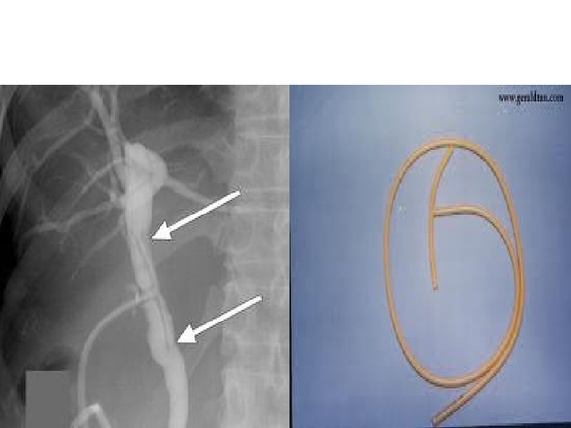

Slide 50
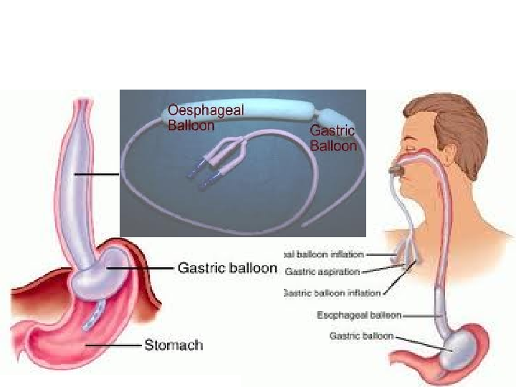
Blackemore Sengstaken tube

Slide 51
Genitorinary tract catheters and tubes :

Slide 52
-Rubber
-Plastic
-Silicon

Slide 53
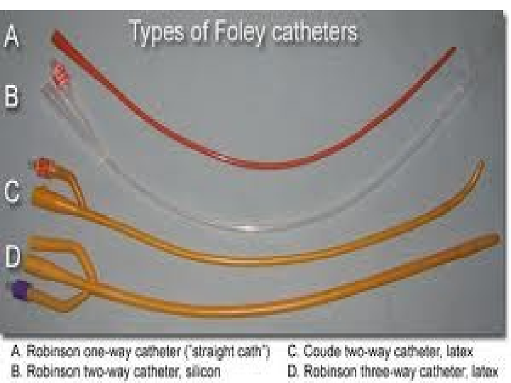

Slide 54
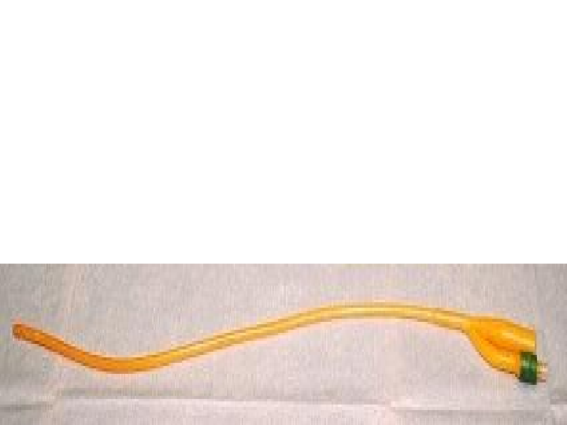
2 Way Foley Catheter

Slide 55
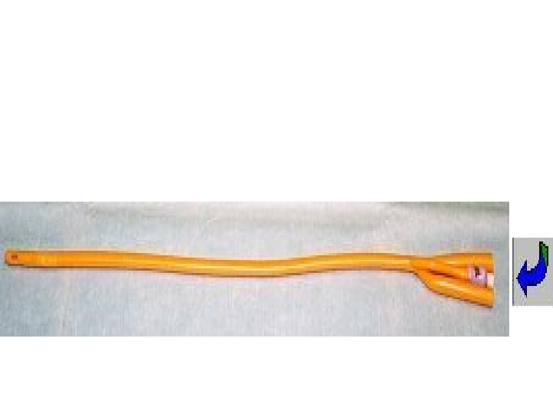
3 Way Foley Catheter Has an inlet for irrigation

Slide 56
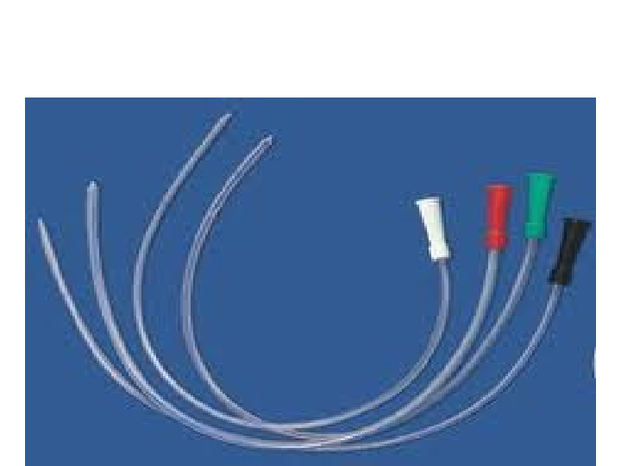
Nilatone(straight)catheter

Slide 57
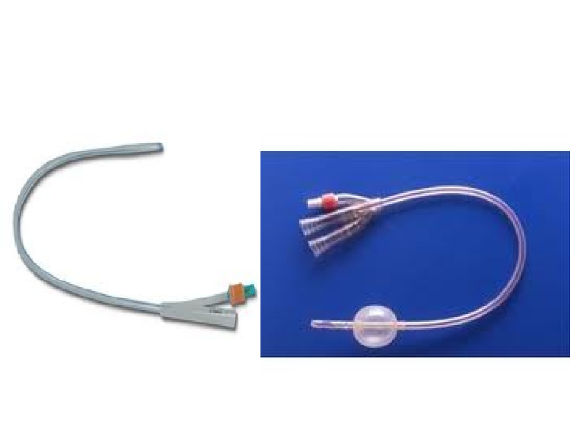
Silicone catheter

Slide 58
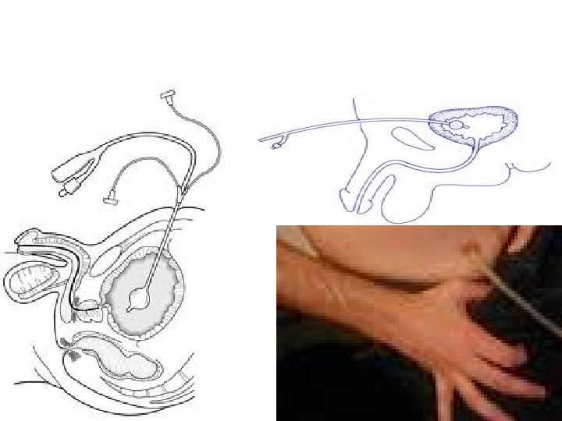
Suprapubic catheter

Slide 59
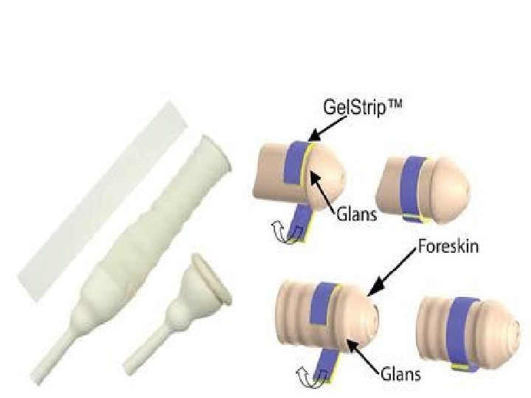
Condom catheter

Slide 60
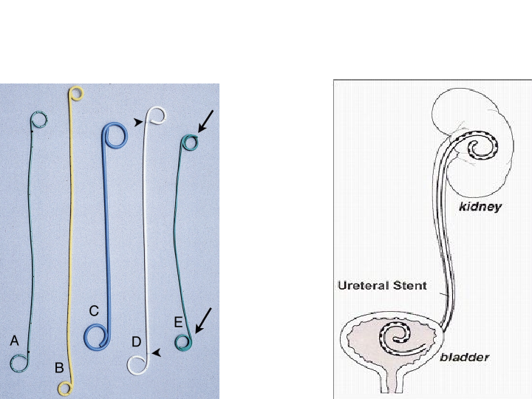
Double J catheter

Slide 61
Nephrostomy tubes Malecot ,Pigtail

Slide 62
Vascular tubes Butterfly needle

Slide 63
IV cannula

Slide 64
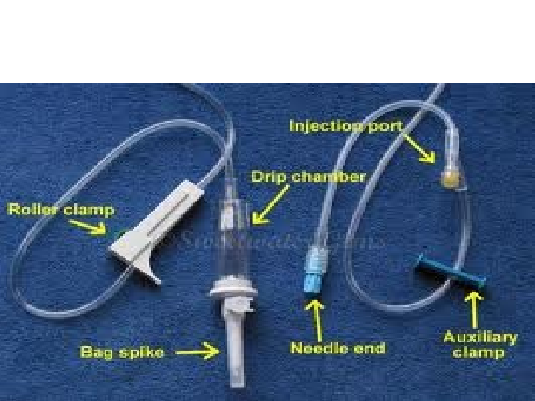
IV set (venoset)

Slide 65
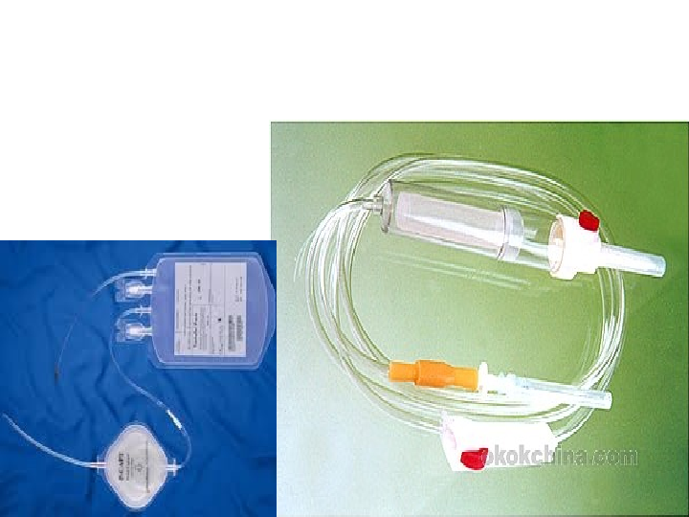
BT(blood transfusion)set

Slide 66
Spinal needle

Slide 67
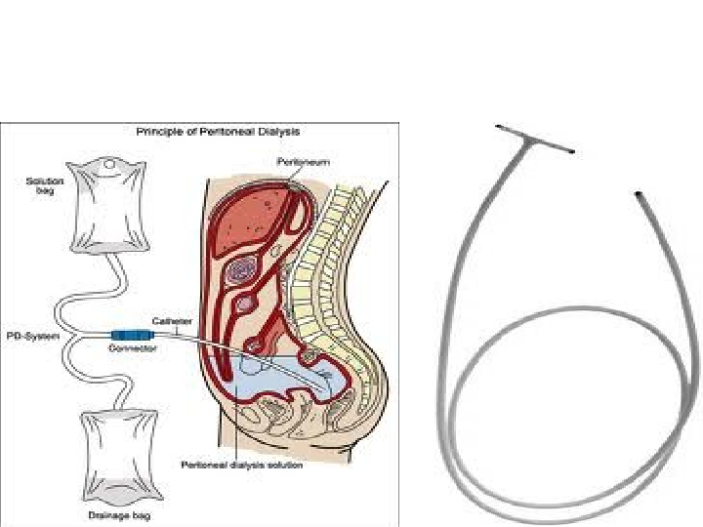
Peritoneal catheter

